Slide 1
Chapter 10
Canonical Correlation Analysis

Slide 2
10.1 INTRODUCTION
Canonical correlation analysis seeks to identify and quantify the associations between two sets of variables. H. Hotelling ([5],[6]), who initially dev-eloped the technique, provided the example of rel-ating arithmetic speed and arithmetic power to re-ading speed and reading power. (See Exercise 10.9) Other examples include relating governme-ntal policy variables with economic goal variables and relating college “performance” variables with precollege “achievement” variables.

Slide 3
Canonical correlation analysis focuses on the correlation between a linear combination of the variables in one set and a linear combination of the variables in another set. The maximization as-pect of the technique represents an attempt to con-centrate a high-dimensional relationship between two sets of variables into a few pairs of canonical variables.

Slide 4
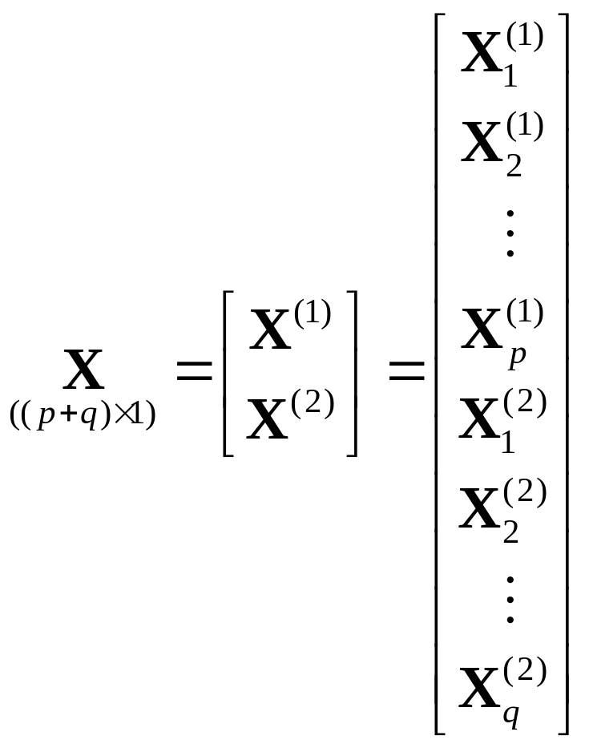
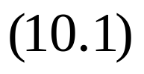
10.2 CANONICAL VARIATES AND CANONICAL CORRELATIONS

Slide 5



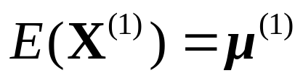
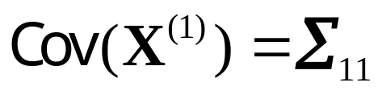
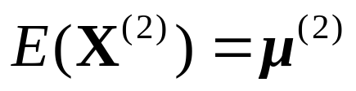
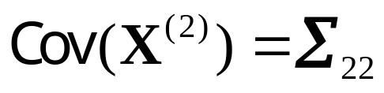
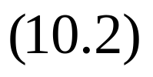
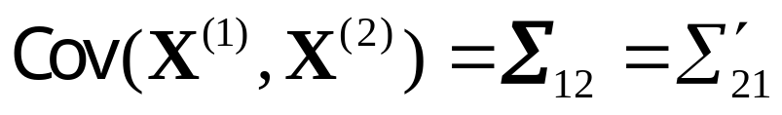
It will be convenient to consider and joi-ntly above. We assume, in the theoretical develop-ment, that represents the smaller set, so that
.
For the random vectors and , let
;
;

Slide 6

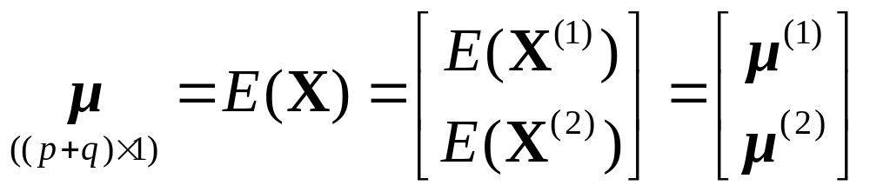
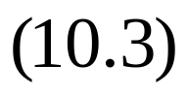
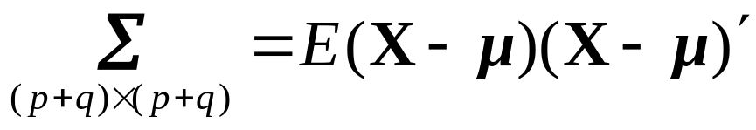
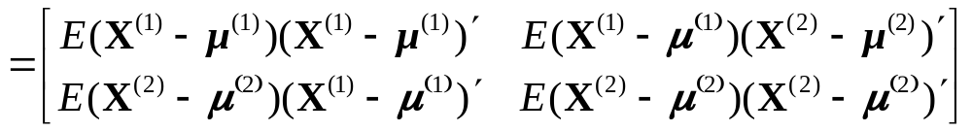
has mean vector
and covariance matrix

Slide 7
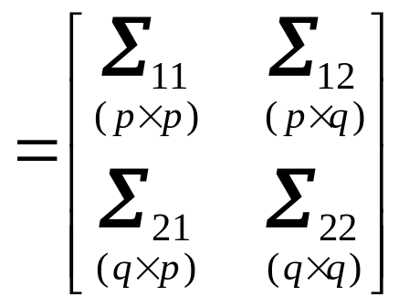
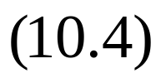

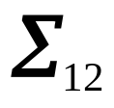
The main task of canonical correlation analy-sis is to summarize the associations between the and sets in terms of a few carefully chosen covariances (or correlations) rather than the co-variances in .

Slide 8
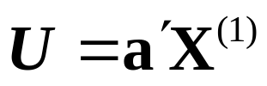
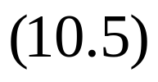
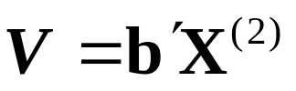
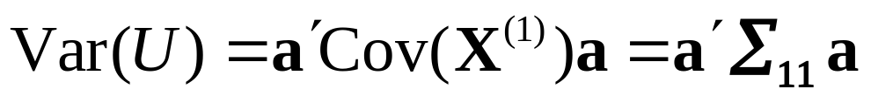
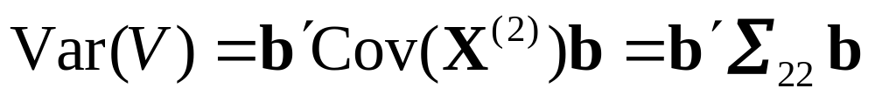
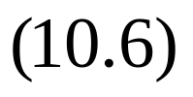
Linear combinations provide simple summary measures of a set of variables. Set
for some pair of coefficient vectors a and b. then, using (10.5) and (2.45), we obtain

Slide 9
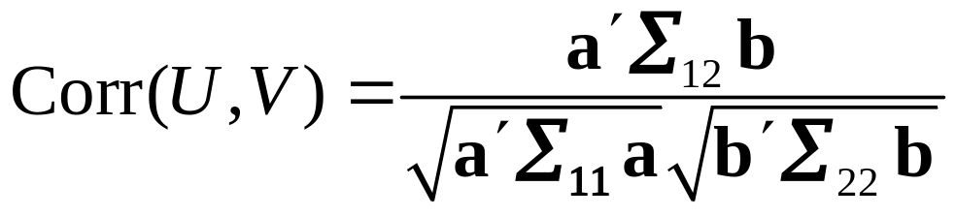
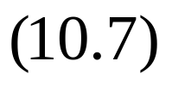


We shall seek coefficient vectors a and b such that
is as large as possible.
We define the following:
The first pair of canonical variables, or first canonical variate pair, is the pair of linear combi-nations , having unit variances, which

Slide 10
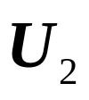


maximize the correlation (10.7);
The second pair of canonical variables, or second canonical variate pair, is the pair of linear combinations , having unit varian-ces, which maximize the correlation (10.7) among all choices that are uncorrelated with the first pair of canonical variables.
At the kth step,

Slide 11
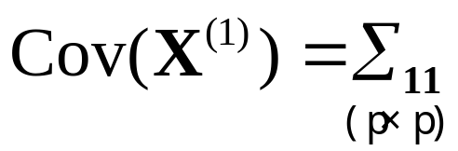
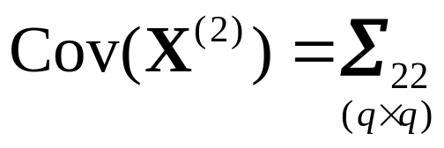
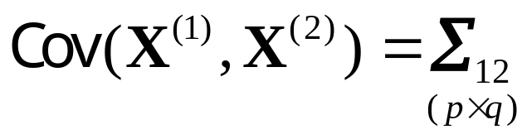

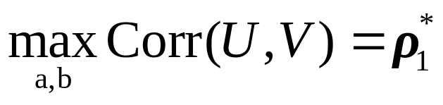
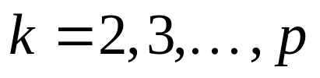
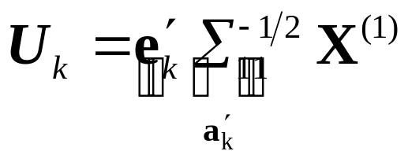
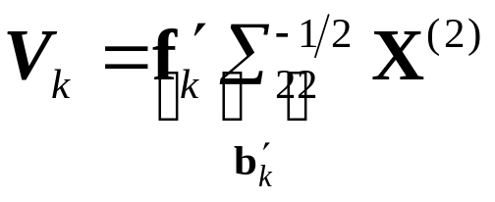
Result 10.1. Suppose and let the random vectors and have
, and ,
where has full rank. then
The kth pair of canonical variables, ,

Slide 12
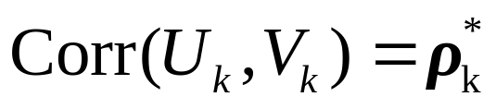
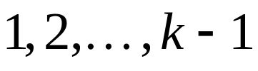
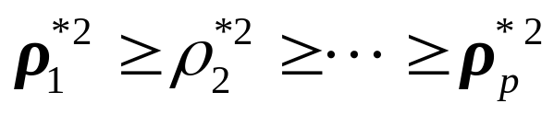
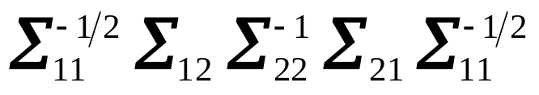
maximizes
Among those linear combinations uncorrelated with the preceding canonical variables.
Here are the eigenvalues of
.

Slide 13
Example 10.1 (Calculating canonical variates and canonical correlations for standardized variables)
P.549

Slide 14
10.3 INTERPRETING THE POPULATION CANONICAL VARIABLES

